Slide 1

Python

Slide 2
Python
Daniel Trahan
Email: Daniel.Trahan@Colorado.edu
RC Homepage: https://www.colorado.edu/rc
Sign in! http://tinyurl.com/curc-names
Slides available for download at: https://github.com/ResearchComputing/SWE_Fall_2021

Slide 3
Outline
Why Python
Installing Python
‘Hello World’
Variables
Functions
Lists and Iterations

Slide 4
Why Python
Python is an interpreted programming language that is relatively simple to get started with.
Syntax is very forgiving
Dynamic Memory Allocation
Dynamic Typing
No Compiling!
Great as a learning tool, powerful as a
Used in a lot of Data Science
Machine learning Utility

Slide 5
Python, an Interpreted Language
Python is an interpreted language
What does this mean?
Separate program (the interpreter) runs Python code.
Interpreters execute code “naively.” (line by line)
Compilers take holistic approach. Interpreters do not.
Efficiency losses when compared to compiled code.

Slide 6
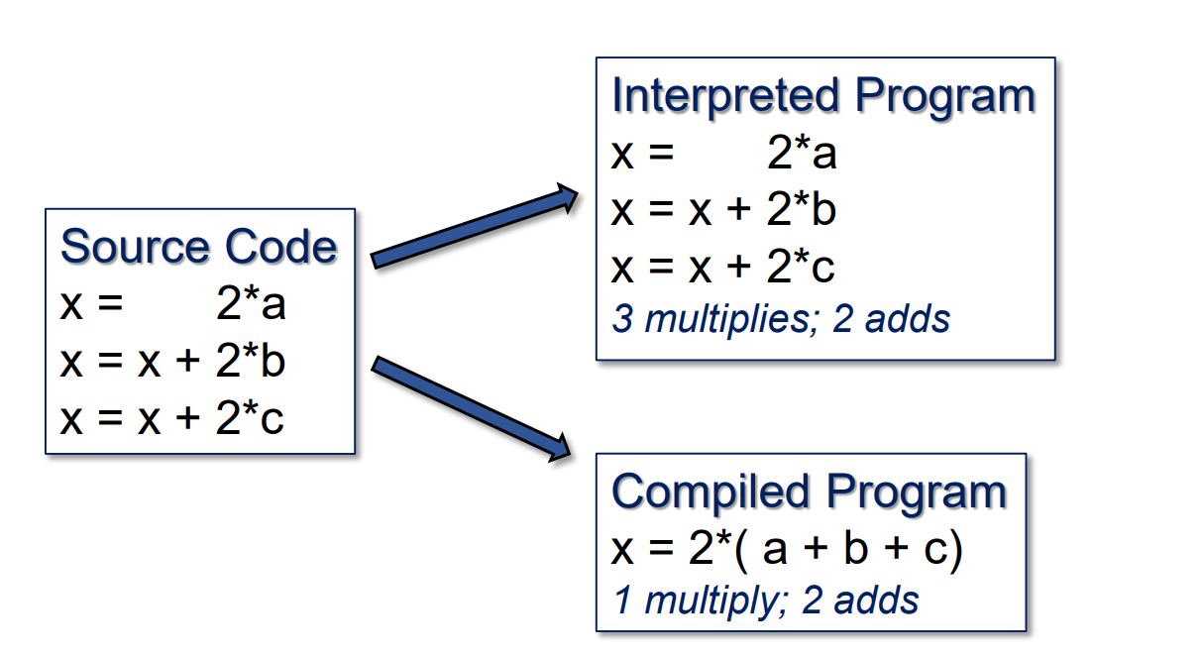
An Interpreted Language…

Slide 7
Executing Python
Python code is very versatile and can be executed in various ways…
Command Line:
Interactive Interpreter:
$ python <your-python-script>
$ python

Slide 8
Jupyter Notebooks
The way we will be utilizing python is through Jupyter notebook
Jupyter Notebook is a Python IDE that runs through your browser.
Opens a file browser where you can create or open new Notebooks
Notebooks are simply interactive sessions of this IDE
To Open Jupyter, simply open Anaconda Navigator
Click on the Jupyter Notebook Box in the Home tab

Slide 9
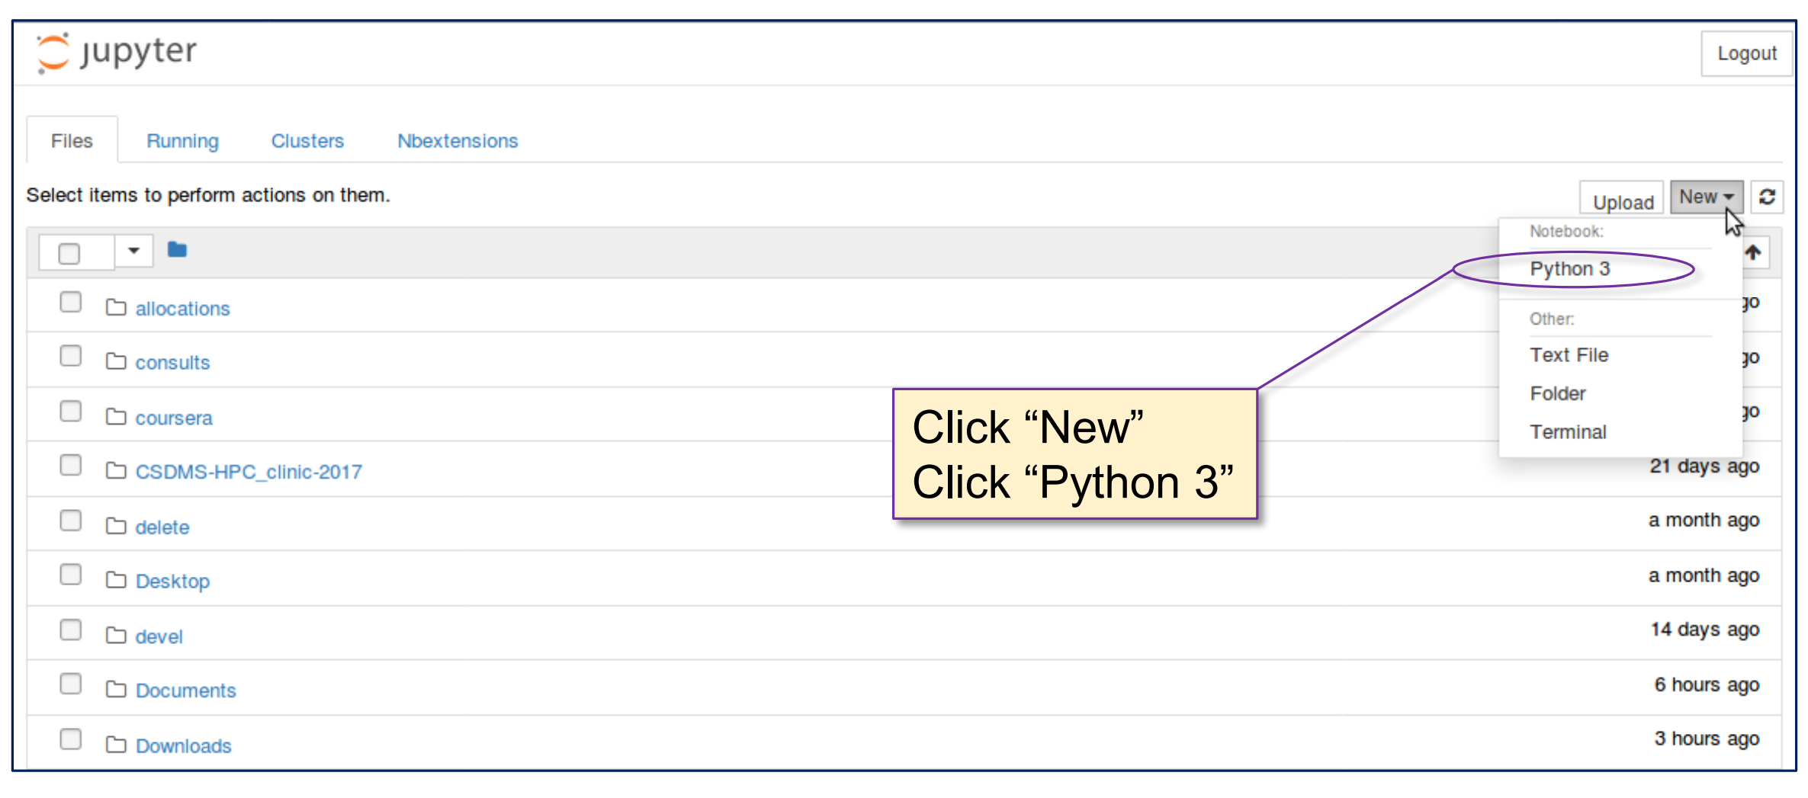
Jupyter Notebooks

Slide 10
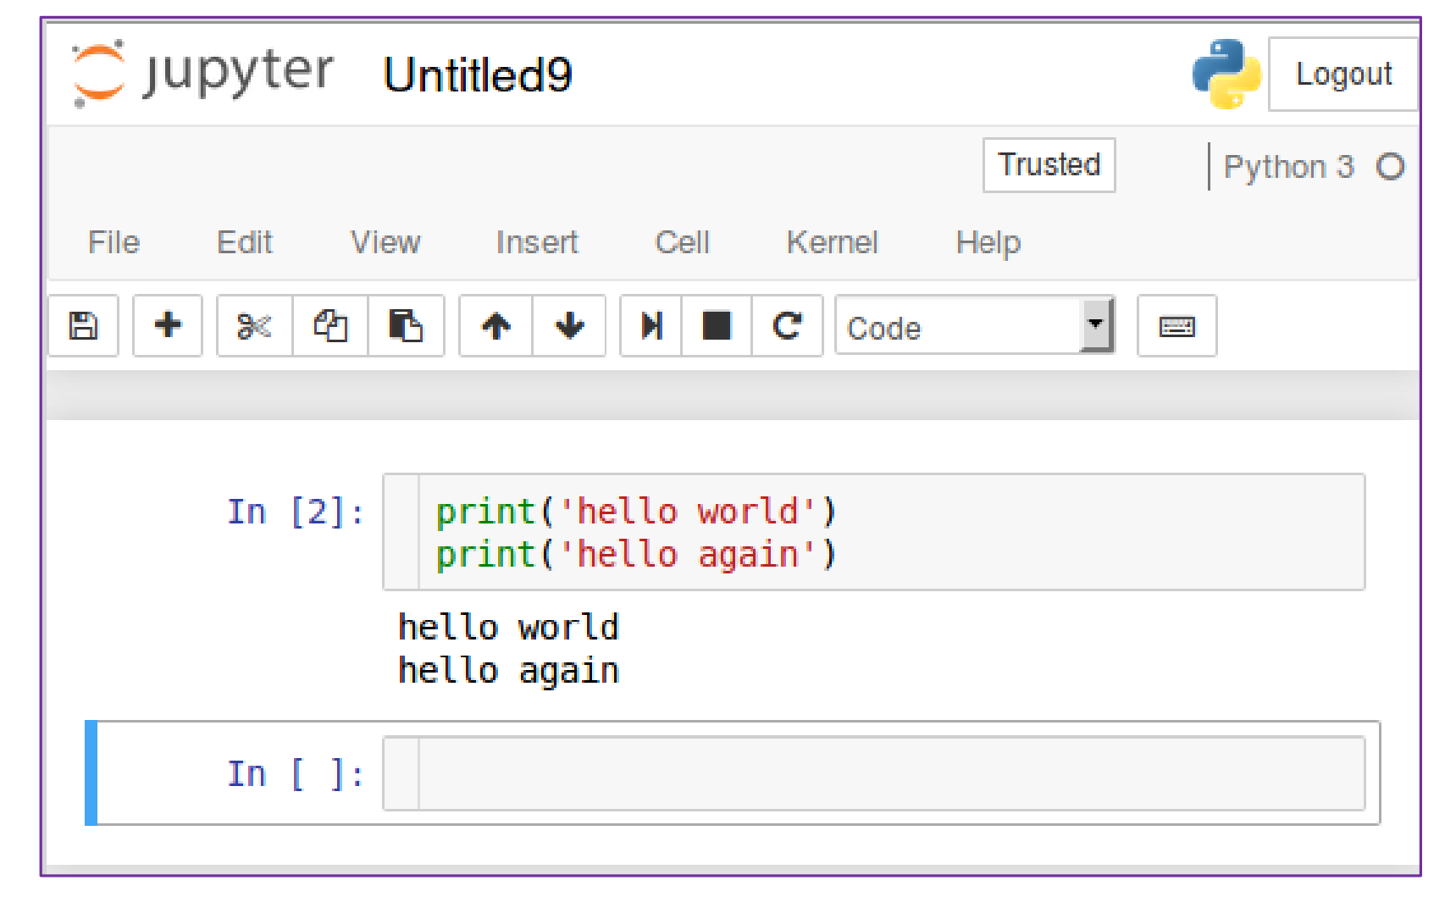
The Jupyter Interface

Slide 11
Hello World
In your Jupyter Notebook click on the first cell and type:
Press Shift + Enter
This is a complete Python program!
…no semicolons, brackets
…no “begin program,” or “end program”
Outside of Jupyter the script is saved as a “.py” file
print(“hello, world!”)

Slide 12
Python Print Statement
print(item1, item2, item3, ..., sep=‘ ’, end=‘\n’)
item1, item2, item3
Comma-separated list of variables whose values you wish to display
sep:
optional keyword parameter
separation string inserted between displayed values (defaults to whitespace)
end:
optional keyword parameter
string appended to end of printed values (defaults to newline)

Slide 13
Python Variables
Variables are not declared but implicitly typed
Created at assignment time
Examples
z = 2 int
y = 3.0 float
Z = “hello” str
z = True bool
NOTE: Python is CASE SENSITIVE (z is not Z)
Can Check type using the type function:
print(“z is: ”, type(z))

Slide 14
Arithmetic in Python
Arithmetic in Python follows order of operations
Addition: +
Subtractrion: -
Mulitplication *
Division /
Floor Division //
Modulo (Remainder) %
Exponentiation **
Some operators can work with strings!
X = ‘hello’ + ‘world’
print(X) -> displays ‘Hello, World’

Slide 15
Type Casting in Python
Variables can be recast using type conversion functions
x = int ( 43.4) -> x = 43
y = float (x) -> y = 43.0
z = str ( x ) -> z = “43”
n = bool ( 0 ) -> n = False
m = bool ( x ) -> m = True

Slide 16
Basic User Input
The input function can be used to grab user input:
num_str = input( “Enter a number: “ )
cat_name = input ( “What is your cat’s name?” )
Accepts one string argument that contains the prompt seen by the user.
Note that it ALWAYS returns a string.
Recast as int or float to do math…

Slide 17
Functions in Python
Functions are lines of code that can be executed repeatedly throughout an application.
In Python, must be defined before called
Example:
Lets break this down!
def afunc(a, b, c=1):
d = c * (a + b)
return d

Slide 18
Functions
“def” keyword
Function name
Parameters
def afunc(a, b, c=1):
d = c * (a + b)
return d
Colon
4 Spaces
Function Body
Return statement + value

Slide 19
Calling Functions
def afunc(a, b, c=1):
d = c * (a + b)
return d
myval = afunc(1, 2, 4)
Functions may be called once defined
Value of d assigned to myval via return statement

Slide 20
Conditionals
boolean expression
3 Conditionals exist within Python
Execute on satisfaction of the expression
if, else, elif
Follow syntax like function definitions:
“if” keyword
if(a > b):
a = b
b = -b
Colon
4 Spaces
Executed if “ a > b
“elif” keyword
boolean expression
“elif” keyword
boolean expression
elif(a < b):
a = -b
b = a
Colon
else:
a = -a
b = -b
Colon
4 Spaces
4 Spaces
Executed if fails other conditional
Executed if a < b

Slide 21
Lists
Lists are collections of data grouped together
Enclosed with brackets
Can be different types
Index starts at 0
mylist = [41, ‘apple’, 1.1, True]

Slide 22
Iteration: For Loop
Loop variable
“in” keyword
“for” keyword
List expression
for i in expr:
print(i)
Colon
4 Spaces
Loop body
For each element in expr:
Assign its value to ‘i’
Execute statements in loop body

Slide 23
Questions?

Slide 24
Thank you!
Please fill out the survey: http://tinyurl.com/curc-survey18
Sign in! http://tinyurl.com/curc-names
Contact information: rc-help@Colorado.edu
Slides: https://github.com/ResearchComputing/SWE_Fall_2021

